Slide 1
Balloon Array for RBSP Relativistic Electron Losses

Slide 2
BARREL TEAM
Dartmouth College
Robyn Millan
Mary Hudson
David McGaw
Leslie Woodger
*Jessica Hewitt
Karl Yando
Brett Anderson
Nick Knezek
Julianna Scheiman
Mike D’Andrea
* Now at USAF Academy
University of Washington
Michael McCarthy
Amanda Baker
U. C. Berkeley
John Sample
Bob Lin
U. C. Santa Cruz
David Smith
Max Comess
Andrew Liang
Warren Rexroad

Slide 4
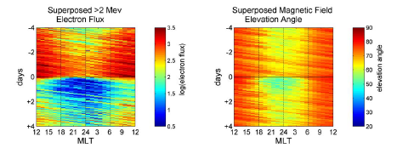
Electron Losses
Decreases of the trapped electron flux can be rapid and catastrophic
Depletions in >2 MeV electron flux measured by GOES spacecraft
(Onsager et. al, 2002)
Superposed epoch study of 52 depletion events => real losses of electrons
(Green et al., 2004)
Electrons still gone
...even after magnetic field returns to dipolar

Slide 5
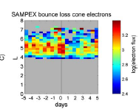
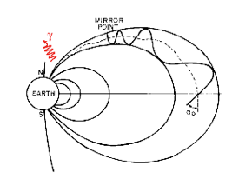
Precipitation Losses
Precipitation into the atmosphere plays an important role.
Increase in SAMPEX bounce loss cone flux => precipitation
(Green et al., 2004)
Electrons scattered to small pitch angles (for example by plasma waves) and collide with the atmosphere: Bm = Beq/sin²αeq
Difficult to measure with equatorial spacecraft since equatorial loss cone is very small and difficult to resolve.

Slide 6
BARREL Project Overview
BARREL is a multiple-balloon experiment designed to study relativistic electron precipitation
Two Antarctic Science Campaigns during RBSP Mission
20 small balloon payloads in each campaign in 2013 and 2014
Launched successively to set up slowly drifting array
Long duration balloon flights => 30 day campaign
>3000 hours of data in radiation belt region (L<7)
Launch sites planned: Halley Bay and South African Antarctic station (SANAE)

Slide 7
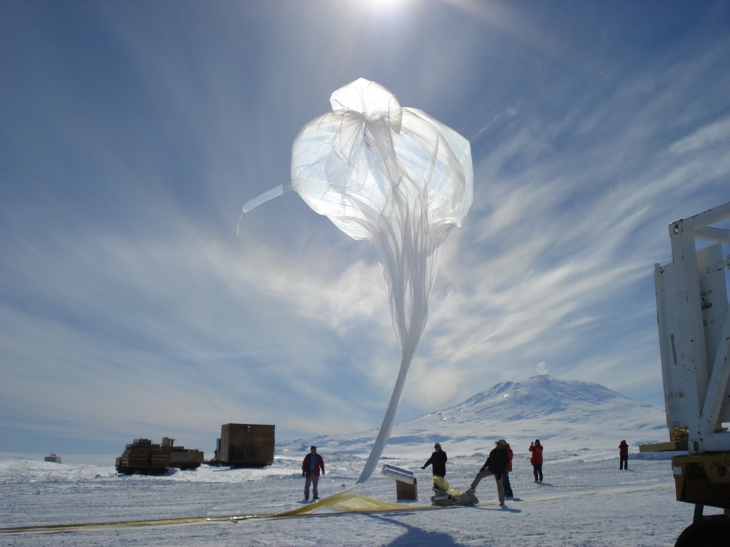
Science Objectives
Determine electron loss rate during specific relativistic electron events
Simultaneously measure precipitation over a wide range of magnetic local times.
Directly test models of wave-particle interactions
Combine balloon measurements of precipitation with in situ RBSP measurements of plasma waves and particles
Determine relative importance of different classes of precipitation
Occurrence probability maps in L-value and MLT
Determine spatial extent and large-scale structure of precipitation.
Multi-point measurements provide large-scale coverage and resolve spatial-temporal ambiguity.

Slide 8
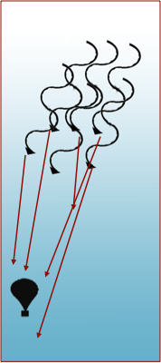
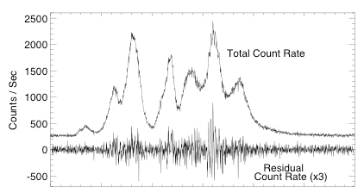
Balloon Observations of Loss
Bremsstrahlung X-rays are produced as electrons collide with atmospheric neutrals.
~70 km
Balloon observations of MeV X-rays made in 1996 over Kiruna, Sweden
The nearly-stationary balloon platform is complimentary to spacecraft observations
~30 km

Slide 10
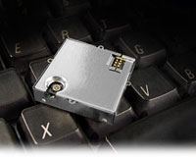
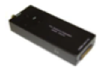
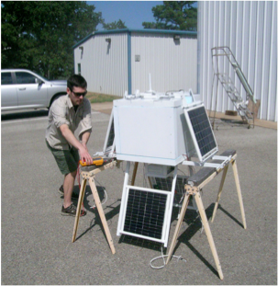
Payload Design
Supporting Instrumentation
GPS time and position: Trimble Lassen SQ
Data Acquisition System
Telemetry: Iridium satellite network ~2kbps
Payload
Suspended mass: 25 kg (payload ~20 kg)
Power: ~6W supplied by solar power system
Hand launched on 300,000 cu ft. balloon to float altitude ~36 km

Slide 12
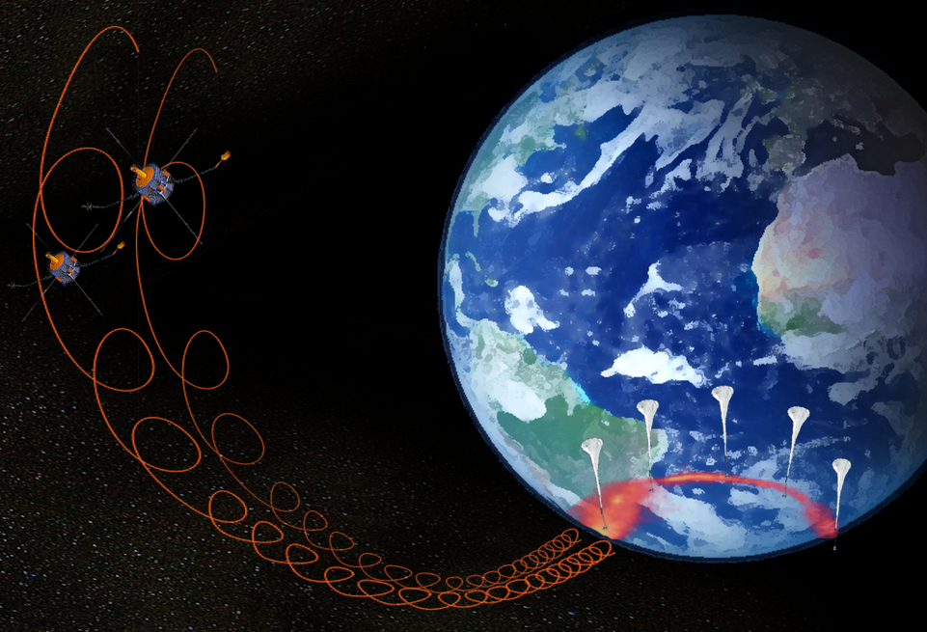
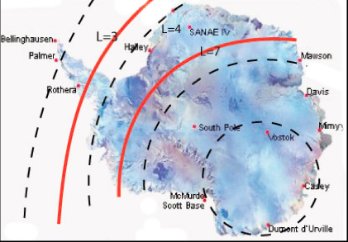
Platform - Balloon Array
BARREL uses an array of balloons to achieve its science
- 4-5 balloons aloft simultaneously
- separation 1-2 hours of MLT
- flight durations ~7 days
- 20 balloons per campaign
Two launch sites:
Halley Bay
SANAE

Slide 13
Platform - Balloon Array
BARREL uses an array of balloons to achieve its science
- 4-5 balloons aloft simultaneously
- separation 1-2 hours of MLT
- flight durations ~7 days
- 20 balloons per campaign
Two launch sites:
Halley Bay
SANAE

Slide 16
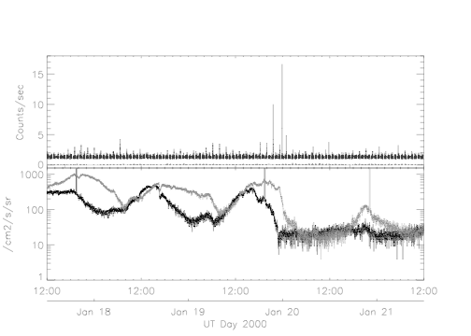
Flux Depletion Events
Precipitation observed by POES during GOES dropout event
Precipitation maps to distances inside geosynchronous satellites
GOES sampling open drift paths for at least part of the time
(Millan et al., 2010)

Slide 17
BARREL with Other Resources
Strengths of balloon-based measurements:
know definitively that what we’re seeing is precipitating electrons
can separate temporal and spatial variations
array provides multi-point measurements
How can we best combine our data with other observations?
- unique opportunity to measure precipitation, particle distributions, and waves simultaneously
- compare precipitation rate with trapped flux
- map the location of precipitation to the equatorial plane
- comparison with riometer data - cross calibration of two methods
- combine with ground based measurements of ULF and EMIC waves
- quantitatively test wave-particle interaction theories

Slide 18
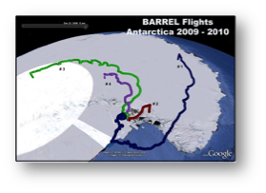
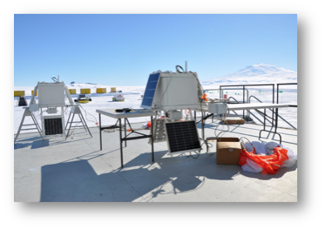
BARREL Project Status
Series of test flights conducted in 2008, 2009, 2010
Successful Confirmation Review in March 2010
I&T of first science payload in late July 2011

Slide 19
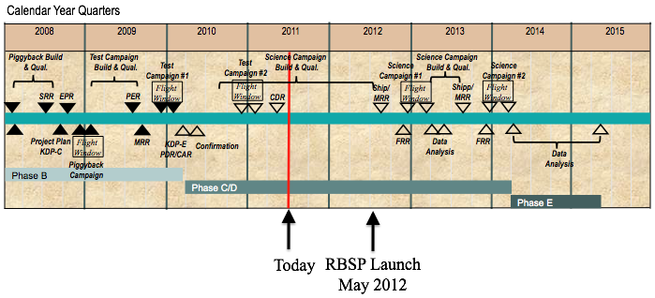
Schedule

Slide 21
Information BARREL Provides
Available near real-time (within 1 hour)Balloon locations – where are measurements available?
Times of conjunctions with RBSP.Quick-look plots (e.g. count rates, raw spectra)Is there energetic precipitation at a given location and time?
Data publicly available: Ascii, CDF, IDL save files – uncalibrated data extracted from binary filesFast Spectra: X-ray count rate in 4 energy channels at 50ms Higher resolution 48 channel X-ray spectra every 4 sec.Highest resolution 256 channel X-ray spectra accumulated over 32 s (for calibration)Requiring more processing (bkgnd subtraction; modeling response, etc.)Flux and energy spectrum of precipitating electrons for specific events.Spatial distribution of precipitation (maps)IDL software tools For plotting data and balloon locationsSpectral analysis and inversion of X-ray spectrum, instrument response

